Slide 1
Introduction to Data Processing
Data Preprocessing Program
Lecturer: Shakhnoza Muksimova
shakhnoza02@gachon.ac.kr
04.09.2025

Slide 2
Content
Overview of Data Processing
Importance of Data Processing
Applications of Data Processing

Slide 3
Software Setup:
Installation and setup of necessary software: Python
Install the latest version of Python from the official website.
Jupyter Notebooks: Install Jupyter Notebooks using Anaconda or pip.
Brief introduction to Python and Jupyter Notebooks.

Slide 4
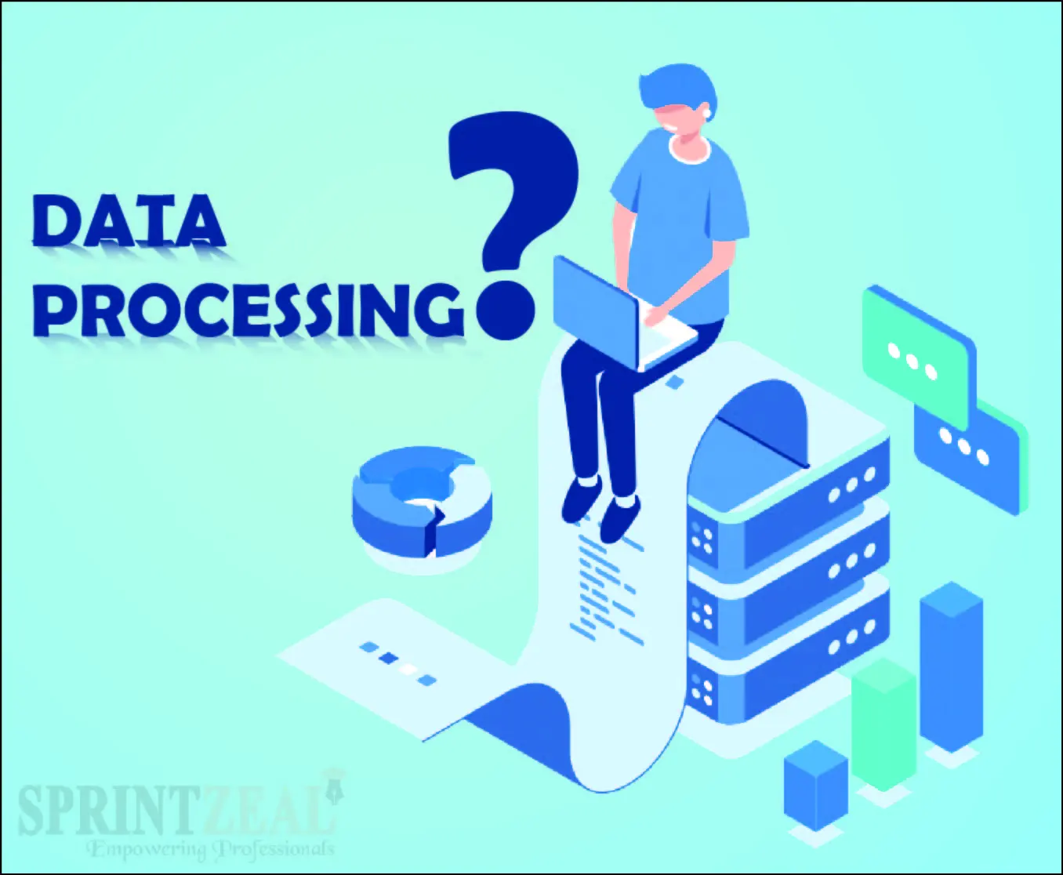
What is data processing
Data in its raw form is not useful to any organization. Data processing is the method of collecting raw data and translating it into usable information. It is usually performed in a step-by-step process by a team of data scientists and data engineers in an organization. The raw data is collected, filtered, sorted, processed, analyzed, stored, and then presented in a readable format.

Slide 5
Why is it important?
The importance of data preprocessing in machine learning cannot be overstated, as it is the cornerstone of any successful data analysis or machine learning endeavour. In the field of data-driven technologies, the quality and suitability of data directly impact the results and performance of machine learning models.

Slide 6
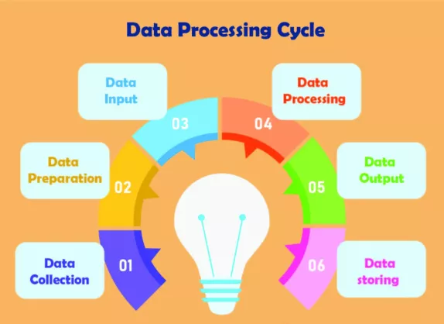
Since the processing of data is done step by step, the data processing cycle involves these six major steps.

Slide 7
Data Collection
The first stage of data collection involves gathering and discovering raw data from various sources, such as sensors, databases, or customer surveys. It is essential to ensure the collected data is accurate, complete, and relevant to the analysis or processing goals. Care must be taken to avoid selection bias, where the method of collecting data inadvertently favors certain outcomes or groups, potentially skewing results and leading to inaccurate conclusions.

Slide 8
Data Preparation
Once the data is collected, it moves to the data preparation stage. Here, the raw data is cleaned up, organized, and often enriched for further processing. This stage involves checking for errors, removing any bad data (redundant, incomplete, or incorrect), and enhancing the dataset with additional relevant information from external sources, a process known as data enrichment. Data preparation aims to create high-quality, reliable, and comprehensive data for subsequent processing steps.

Slide 9
The Data Input
The next stage is data input. In this stage, the clean and prepped data is fed into a processing system, which could be software or an algorithm designed for specific data types or analysis goals. Various methods, such as manual entry, data import from external sources, or automatic data capture, can be used to input data into the processing system.

Slide 10
Data Processing
In the data processing stage, the input data is transformed, analyzed, and organized to produce relevant information. Several data processing techniques, like filtering, sorting, aggregation, or classification, may be employed to process the data. The choice of methods depends on the desired outcome or insights from the data.

Slide 11
Data outputs
- The data output and interpretation stage deals with presenting the processed data in an easily digestible format. This could involve generating reports, graphs, or visualizations that simplify complex data patterns and help with decision-making. Furthermore, the output data should be interpreted and analyzed to extract valuable insights and knowledge.

Slide 12

Data Storage
- Finally, in the data storage stage, the processed information is securely stored in databases or data warehouses for future retrieval, analysis, or use. Proper storage ensures data longevity, availability, and accessibility while maintaining data privacy and security.

Slide 13
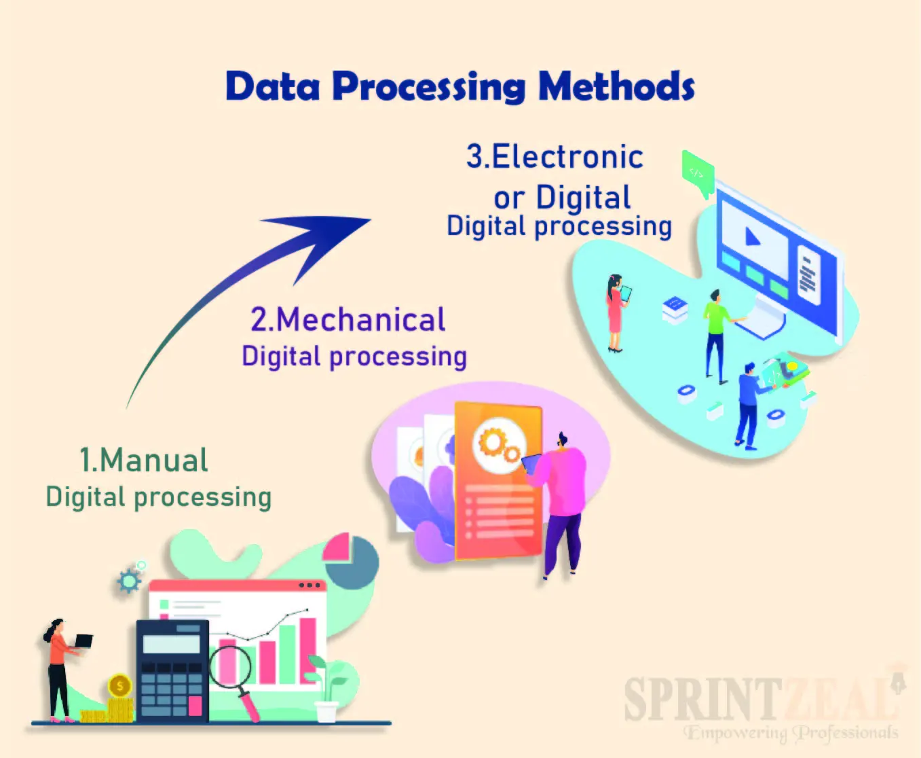
What are the 3 methods of data processing?
Depending on the tools available and the type of data being processed, there are mainly three different methods to go about data processing. The methods are as follows.

Slide 14
Manual Data processing
In this type, the data collected from the eternal resources is converted manually and subjected to human-based algorithms and calculations. All the necessary calculations are done manually without using any machines or tools for the data processing results. All the logical operations are performed manually. This method always led to errors and non-structural data processing.

Slide 15
Mechanical data processing
When the data is processed using some mechanical tools, like typewriters, mechanical printers, or any other mechanical tool, such a processing method is called mechanical data processing. When compared to manual data processing, mechanical data processing is a time-saving method since the tools used make the process finish faster. Even the errors generated are relatively low. It is best suited for simple processing tasks.

Slide 16
Electronic or Digital data processing
The raw data collected is processed using the data processing software and tools. Such processing methods are called Electronic data processing. They make use of AI algorithms to perform the data processing of the given data. Such data processing methods are also called "automated data processing." When compared to both mechanical and manual methods, electronic data processing is a lot more efficient since it has no room for human errors. The data handled by the computers is more precise and time-saving.

Slide 17
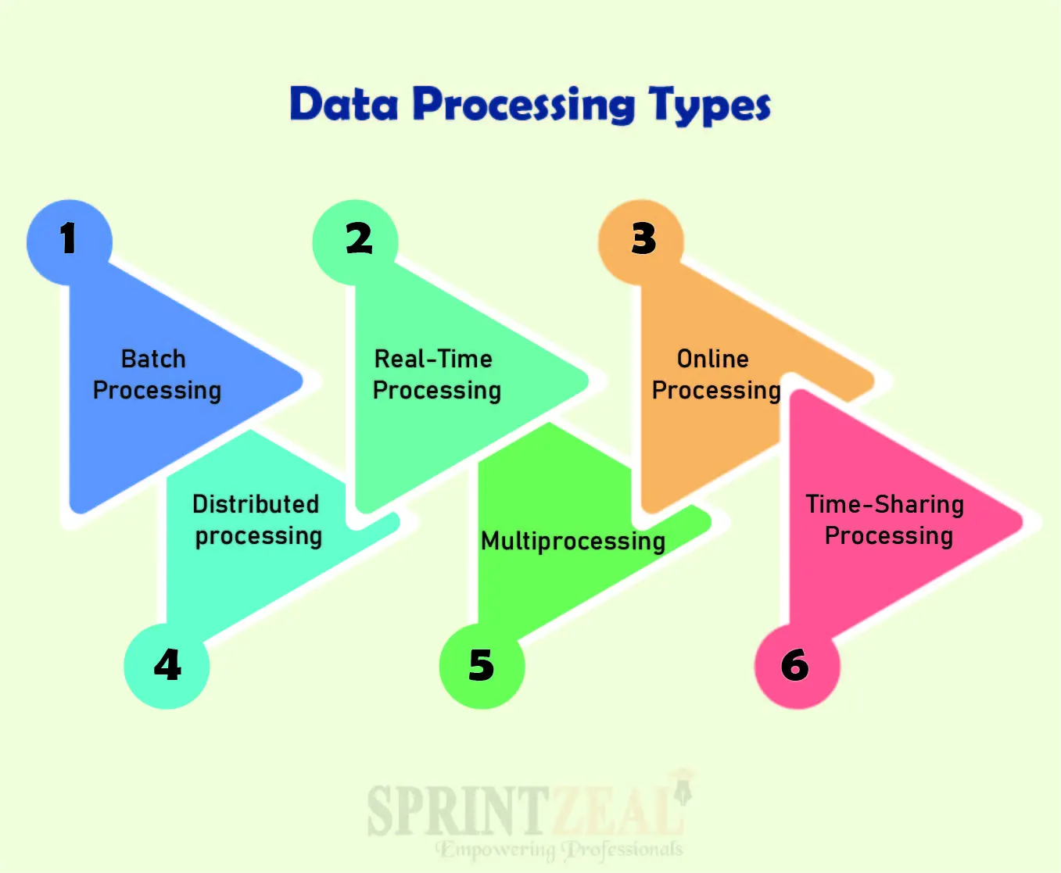
Data Processing Types
Data processing utilizes various methods to convert raw data into meaningful information. These methods can be classified into several types, each catering to different scenarios and requirements.

Slide 18
Batch Data Processing.
In this type of processing, the data fed to the computer is divided into batches. When there is a massive amount of data under processing, it is divided into batches before processing. By this, huge amounts of data can be processed by maintaining the structure of the data.

Slide 19
Real-Time Data Processing
As the name says, real-time processing is a type of data processing that updates the progress in real-time to help users track the status in real-time. This type of processing is most often used for small data packages. Since it requires a lot of RAM to update the progress in real-time, it is often avoided for highly accurate outcomes.

Slide 20

Online Data Processing
This is another type of real-time processing that keeps users informed of progress in real-time. In this type of processing, the data that is being processed relies on other resources like the internet, for example. This helps the progress to be undertaken in real-time and this process becomes hands-free since the data, once fed to the server, gives the output when completed.

Slide 21

Distributed Data processing
This type of processing is an alternative to batch processing. In this, the data is first distributed for different tasks among different servers or among different CPUs. This helps in speeding up the processing cycle.

Slide 22
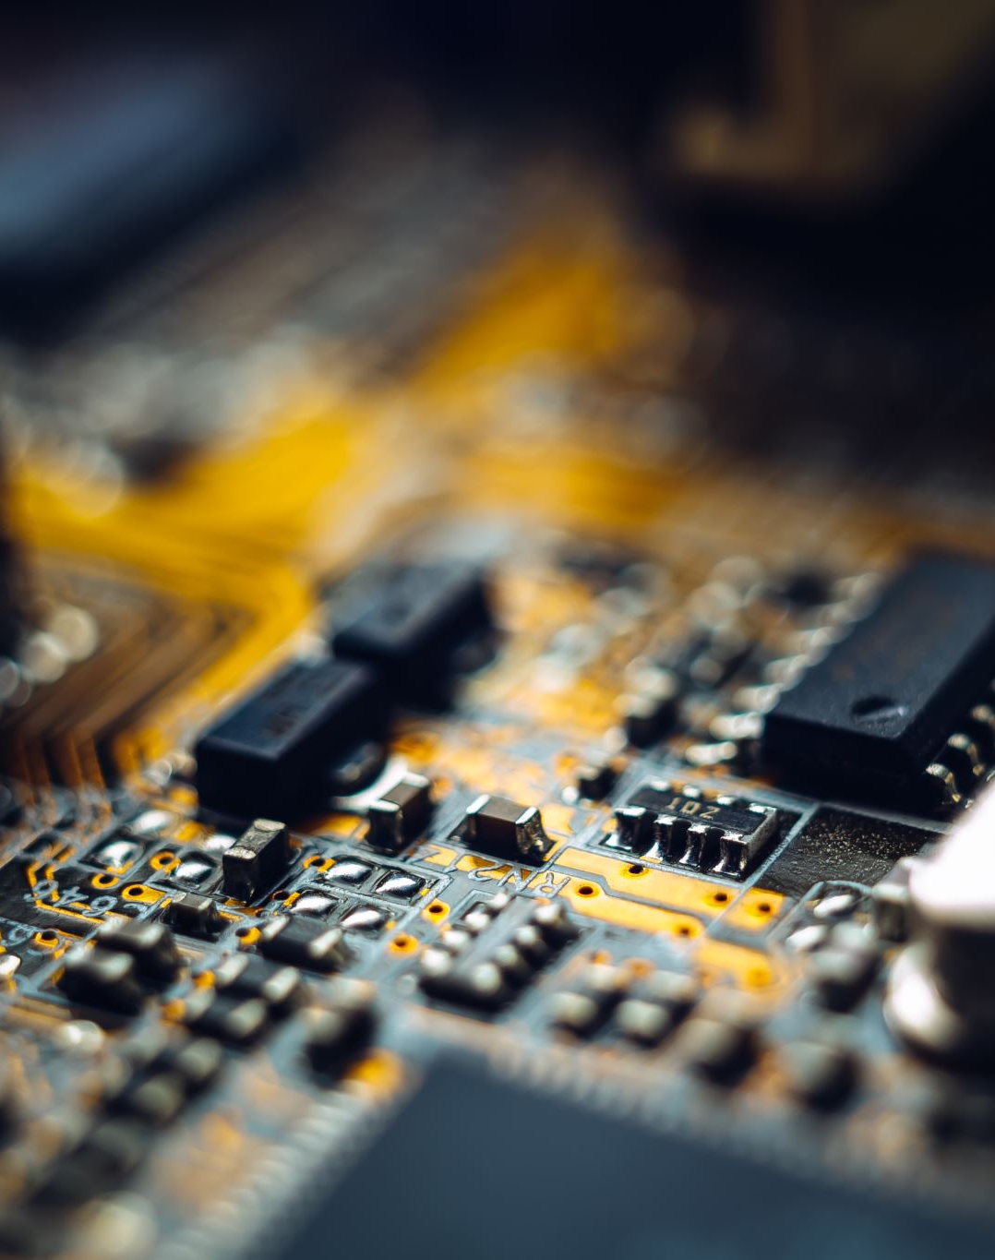
Multiprocessing
In this type of processing, the tasks are assigned to the computers with multiple timeslots. The data is broken down into frames and it is processed using more than two CPUs within the same computer. By this, the processing cycle gets better and the processing of the data consumes less time comparatively. This type is also called parallel processing.

Slide 23

Time-Sharing Data Processing
Allocation of computer resources and the data in timeslots to multiple users simultaneously is called time-sharing data processing. A single CPU can be accessed by multiple users by allocating resources at different timeslots. Each user is provided with a terminal link to the CPU while the CPU time slotting is based on the number of users available at that particular time.

Slide 24
EXAMPLES OF DATA PROCESSING
- The data processing involves statistical calculations of financing, goods, and other data of an e-commerce website.
- A trading organization that constantly exchanges information about the current status of the trades and the user statistics.
- A self-driven car, considering its surroundings in real-time to avoid any collision.
- Streaming platforms use the user's search history to recommend related interests.
- The bank website constantly exchanges the transaction details to update the current balance of the bank accounts in real-time.
- Social platforms accept and receiving the videos and content, converting them into standard formats for quality.

Slide 25
Artificial intelligence & machine learning
As the backbone of many modern data processing methods, artificial intelligence (AI) and machine learning (ML) help organizations uncover patterns and make predictions based on available data. Popular ML languages include Python, R, and SAS, offering flexibility and a wide range of libraries for the data processing workflows.
Some of the most impactful ML techniques in data processing are:
Supervised learning: Training models with labeled data to make predictions
Unsupervised learning: Extracting patterns from unlabeled data, such as clustering or dimensionality reduction
Reinforcement learning: Improving actions on-the-fly based on feedback from the environment
These ML approaches have facilitated breakthroughs in diverse fields, from speech recognition to medical diagnostics.

Slide 26
Data Processing Technical Advantages
- Increases productivity.
- Access to structured data.
- It is a fast and secure process.
- It helps improve the business margin.
- Complex calculations do not take much time.
- Calculation and algorithm errors are highly avoided.

Slide 27
Data Processing Technical Disadvantages
- Memory wastage.
- High power occupancy.
- Installation costs are high.
- Requires huge amounts of storage.
- Maintenance requires extra resources.
- Safekeeping of data is extremely hard to preserve.
- Estimation of work time for processing the data is difficult.

Slide 28
Resources
Textbooks: "Python for Data Analysis" by Wes McKinney, "Data Science from Scratch" by Joel Grus.
Online Courses: Coursera, edX, DataCamp courses on data processing and Python.
Tools: Jupyter Notebook, pandas, NumPy, scikit-learn, matplotlib, seaborn, Spark.

Slide 29
Additional Resources:
Jupyter Notebooks Documentation
Python Official Documentation
NumPy Documentation
Pandas Documentation

Slide 30
Assignments:
Install Necessary Tools and Libraries:
Install Python from Python.org.
Install Jupyter Notebooks:
Option 1: Install Anaconda from Anaconda.com.
Option 2: Use pip to install Jupyter Notebooks (pip install notebook).
Install additional Python libraries needed for the course:
NumPy (pip install numpy)
Pandas (pip install pandas)
Matplotlib (pip install matplotlib)
Seaborn (pip install seaborn)
Verify installations by running a simple script in Jupyter Notebook.

